Slide 1
Forensic Investigation of Echo Show Device
IoT Forensics

Slide 2
Overview of Labs

Slide 3
# | Lab | Topic Covered | No. of Slides
1 | Lab 0 | Introduction of Echo Show 8 (2nd Generation) Device | 17
2 | Lab 1 | Evidence Planting | 17
3 | Lab 2 | Device Teardown and eMMC Chip-off | 25
4 | Lab 3 | Image Acquisition and Mounting | 20
5 | Lab 4.1.1 | Specifications: Device and OS Info | 19
6 | Lab 4.1.2 | Specifications: User Info | 31
7 | Lab 4.1.3 | Specifications: Network Connectivity Info | 13
8 | Lab 4.2.1 | Web Activity | 13
9 | Lab 4.2.2 | Phone Calls | 18
10 | Lab 4.3.1 | Multimedia: Photos and related Data | 28
11 | Lab 4.3.2 | Multimedia: Videos and related Data | 16
12 | Lab 4.3.3 | Multimedia: Audio and related Data | 35

Slide 4
Links to Disk Images, PPTs & Lab Data Folders
Description | Link
Echo Show eMMC Image | https://miya.teracloud.jp/share/11d1e631cf6f8456 MD5: b58fa04967161c158723c7b00a636533
Echo Show Userdata Partition Image | https://miya.teracloud.jp/share/11d15342aae11912 MD5: d841a57eafcd18ccdf30e849f87bb3c7
PPTs | https://github.com/frankwxu/digital-forensics-lab/tree/main/Echo_Device/ppts
Lab files | https://github.com/frankwxu/digital-forensics-lab/tree/main/Echo_Device/lab_data

Slide 5
Links to PPTs
Lab | PPT | Links
Lab_0 | Echo Show Introduction | https://github.com/frankwxu/digital-forensics-lab/blob/main/Echo_Device/ppts/0_Echo_Show_Introduction.pptx
Lab_1 | Echo Show Evidence Planting | https://github.com/frankwxu/digital-forensics-lab/blob/main/Echo_Device/ppts/1_Echo_Show_Evidence_Planting.pptx
Lab_2 | Device Teardown and eMMC Chip-off | https://github.com/frankwxu/digital-forensics-lab/blob/main/Echo_Device/ppts/2_Device_Teardown_and_eMMC_Chip-off.pptx
Lab_3 | Image Acquisition and Mounting | https://github.com/frankwxu/digital-forensics-lab/blob/main/Echo_Device/ppts/3_Image_Acquisition_and_Mounting.pptx
Lab_4_1_1 | Specifications: Device and OS Info | https://github.com/frankwxu/digital-forensics-lab/blob/main/Echo_Device/ppts/4_1_1_Specifications%20_Device_and_OS_Info.pptx
Lab_4_1_2 | Specifications: User info | https://github.com/frankwxu/digital-forensics-lab/blob/main/Echo_Device/ppts/4_1_2_Specifications%20User_info.pptx
Lab_4_1_3 | Specifications: Network Connectivity Info | https://github.com/frankwxu/digital-forensics-lab/blob/main/Echo_Device/ppts/4_1_3_Specifications_Network_Connectivity_Info.pptx

Slide 6
Links to PPTs (Contd.)
Lab | PPT | Links
Lab_4_2_1 | Web Activity | https://github.com/frankwxu/digital-forensics-lab/blob/main/Echo_Device/ppts/4_2_1_Web_Activity.pptx
Lab_4_2_2 | Phone Communication | https://github.com/frankwxu/digital-forensics-lab/blob/main/Echo_Device/ppts/4_2_2_Phone_Communication.pptx
Lab_4_3_1 | Multimedia: Photos and related Data | https://github.com/frankwxu/digital-forensics-lab/blob/main/Echo_Device/ppts/4_3_1_Multimedia_Photos_and_Related_Data.pptx
Lab_4_3_2 | Multimedia: Videos and related Data | https://github.com/frankwxu/digital-forensics-lab/blob/main/Echo_Device/ppts/4_3_2_Multimedia_Videos_and_Related_Data.pptx
Lab_4_3_3 | Multimedia: Audio and related Data | https://github.com/frankwxu/digital-forensics-lab/blob/main/Echo_Device/ppts/4_3_3_Multimedia_Audio_and_Related_Data.pptx

Slide 7
Links to Lab Data
Lab | PPT | Lab Files
Lab_4_1_1 | Specifications: Device and OS Info | https://github.com/frankwxu/digital-forensics-lab/tree/main/Echo_Device/lab_data/Lab_4_1_1
Lab_4_1_2 | Specifications: User info | https://github.com/frankwxu/digital-forensics-lab/tree/main/Echo_Device/lab_data/Lab_4_1_2
Lab_4_1_2 | Specifications: Network Connectivity Info | https://github.com/frankwxu/digital-forensics-lab/tree/main/Echo_Device/lab_data/Lab_4_1_3
Lab_4_2_1 | Web Activity | https://github.com/frankwxu/digital-forensics-lab/tree/main/Echo_Device/lab_data/Lab_4_2_1
Lab_4_2_2 | Phone Communication | https://github.com/frankwxu/digital-forensics-lab/tree/main/Echo_Device/lab_data/Lab_4_2_2
Lab_4_3_1 | Multimedia: Photos and related Data | https://github.com/frankwxu/digital-forensics-lab/tree/main/Echo_Device/lab_data/Lab_4_3_1/rec_jpg_foremost
Lab_4_3_2 | Multimedia: Videos and related Data | https://github.com/frankwxu/digital-forensics-lab/tree/main/Echo_Device/lab_data/Lab_4_3_2
Lab_4_3_3 | Multimedia: Audio and related Data | https://github.com/frankwxu/digital-forensics-lab/tree/main/Echo_Device/lab_data/Lab_4_3_3

Slide 8
Introduction

Slide 9
IoT Forensics
Definition: The process of collecting, analyzing, and preserving digital evidence from Internet of Things (IoT) devices for investigative purposes.
Importance: Crucial for investigating cybercrimes, security incidents, accidents, or any events involving IoT devices.
Purpose: Unveils user traces, interactions, and data for digital forensics investigations.

Slide 10
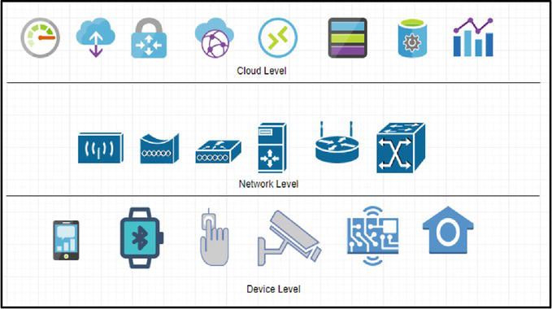
Levels of Investigation in IoT Forensics
Collect data from cloud; most dificult; all possible data resides on cloud
Collect data from netwroks logs; helps inestigate netwrok traffic and identify attackers (if any)
Collect data from local memory of device; limited data due to storage limitation
Source: A Review on the Internet of Things (IoT) Forensics: Challenges, Techniques, and Evaluation of Digital Forensic Tools

Slide 11
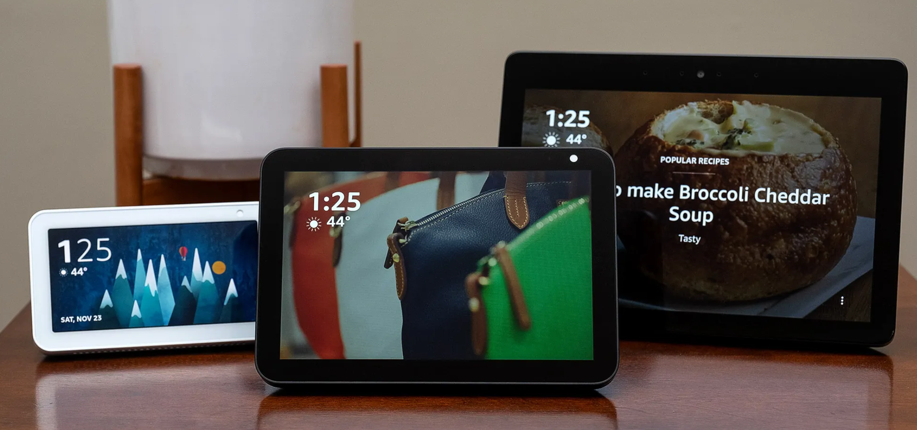
Echo Show Device: An IoT Device by Amazon
Definition: A smart display device, part of their Echo product line.
Features: Voice-activated technology coupled with a user-friendly touchscreen interface.
Significance: IoT devices, like the Echo Show, are integral to our interconnected world
Image Source: The best smart displays for 2021 - The Verge

Slide 12
Echo Device Models & Specifications
Model | Display Size | Internal Storage | RAM | Processor | Release Date
Echo Show (1st Gen) | 7-inch | 8GB eMMC | 1GB | Intel Atom x5-Z8350 | June 2017
Echo Show (2nd Gen) | 10-inch | 8GB eMMC | 2GB | MediaTek MT 8163 | Oct 2018
Echo Show 5 | 5.5-inch | 8GB eMMC | 1GB | MediaTek MT 8163 | June 2019
Echo Show 8 | 8-inch | 8GB eMMC | 2GB | MediaTek MT 8163 | Nov 2019
Echo Show 10 (3rd Gen) | 10.1-inch | 16GB eMMC | 3GB | MediaTek 8183 | Feb 2021
Echo Show 15 | 15.6-inch | 16GB eMMC | 3GB | Amlogic Pop1 | Late 2021

Slide 13
Device Level Forensic Investigation of Echo Show 8
Device Investigated: Echo Device 8 (2nd Gen.)
Purpose: Explore device activity and conduct data recovery.
Objective: Extract the planted evidence from the device.

Slide 14
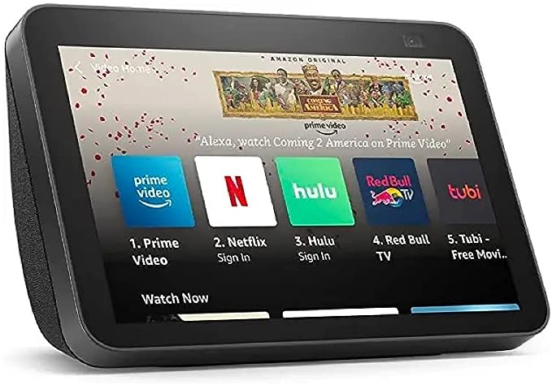
Echo Device 8 (2nd Gen.) Specifications
Display Size | 8-inch
Internal Storage | 8GB eMMC
RAM | 2GB
Processor | MediaTek MT 8163
OS | Fire OS (Android-based)
Release Date | November 2019
Image Source: Echo Show 8 (2nd Gen) (amazon.com)

Slide 15
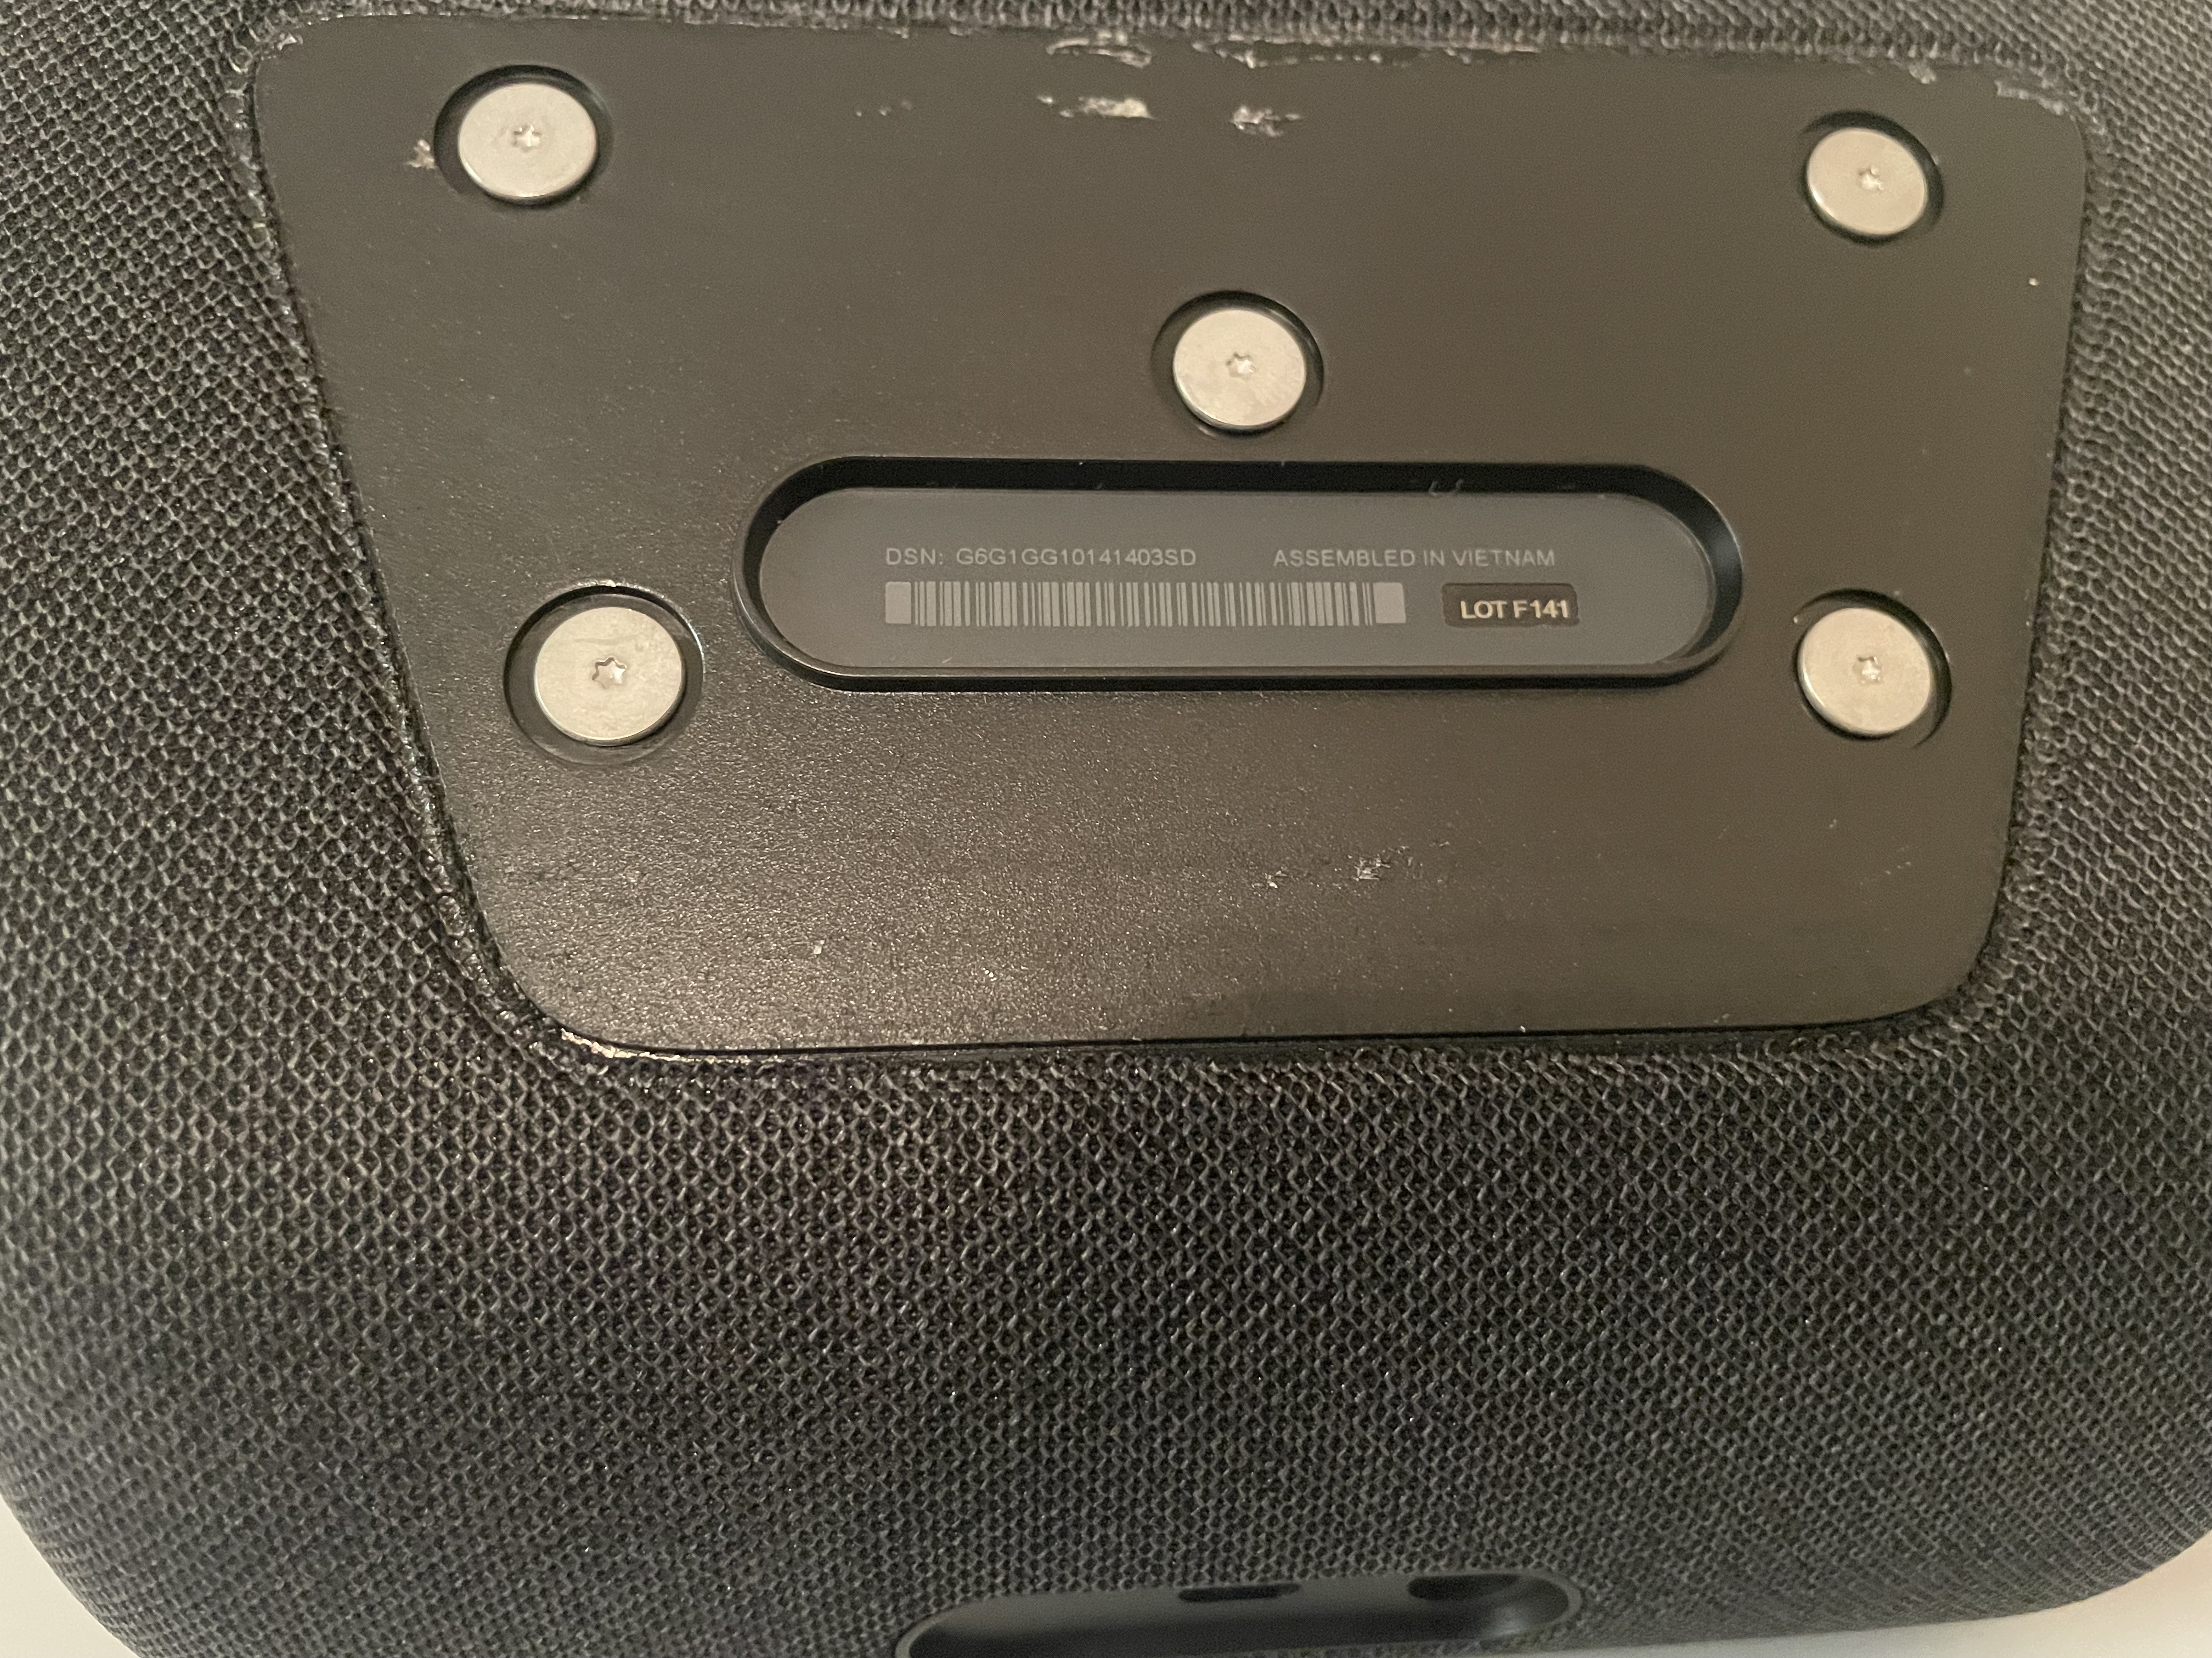
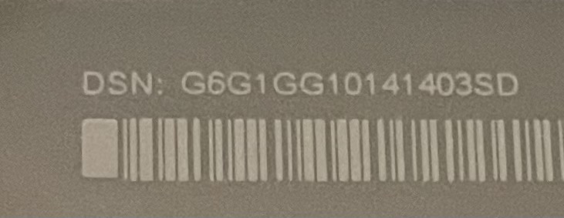
Finding Device Serial Number (DSN)
Location: On the bottom of device
Process: Remove the plate to reveal the Device Serial Number (DSN)
DSN: G6G1GG10141403SD

Slide 16
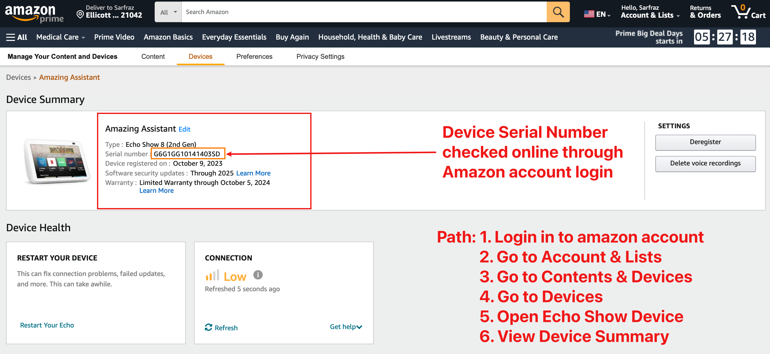
Verify Device Serial Number (DSN) Online

Slide 17
Data Storage on Device Cloud
Data stored on
Internal Storage (eMMC) or
Cloud (Amazon)
No official disclosure of what data stored on the cloud vs internal storage.
Generally, Voice commands saved on the cloud.
Internal storage holds operating system, user apps/skills, device settings, preferences, and other information.
Log files, temporary files, and user data stored internally; some may be deleted by the OS.

